Slide 1

Sleep Improvement Project Syracuse University MBC638
John Fields
15 Mar 2019

Slide 2
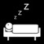




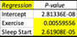
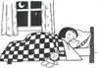

Sleep improvement project
Process Owner: John Fields
Key Dates --->
Launch
1/2/19
Define
1/2/19 – 1/15/19
Measure
1/16/19 – 2/14/19
Analyze
2/15/19 – 2/22/19
Improve
2/23/19 – 3/6/19
Control
3/7/19-3/13/19
DEFINE
MEASURE
ANALYZE
IMPROVE
SQL
1.0
SQL
2.1
Problem
Insufficient sleep is causing decreased focus and retention of information for my graduate classes
Impact
Increasing sleep by 1 hour per night has been shown to increase test scores which would result in a higher starting salary after graduate school which would equate to ~$17,980 in increased income over the next 20 years
Result – The mean for my sleep in 2018 was 6.60 hours per night. The mean for my sleep during the measure phase of this project was 7.29 hours per night.
Goal – Increase Total Sleep per night from 7.29 to 7.60 hours (4% improvement)
Data Collection (n=30)
(Y) Total Sleep Time = F (X1-Exercise, X2-Sleep Start, X3-Reading, X4-Friends, X5-Meals, X6-Personal, X7-Travel, X8-Entertainment, X9-Family, X10-School, X11-Day, X12-Chores)
Result
School, Chores and Personal time were the top categories for time spent over the 30 days that data was collected during the measure phase.
Total Sleep Improved from
7.29 to 7.54 hours, but was this statistically significant?
Tools Utilized
Pareto, Box Plot, Scatter Plot, Regression, Correlation
Impact
Exercise and Sleep Start had the largest correlation with Sleep (Y). Sleep Start had the lowest P-value.
Result
Although, more time is spent on School, Chores and Personal Time, the analysis indicated a focus on going to bed earlier and increasing exercise would increase Total Sleep (Y).
Data Collection (n=12)
Sample size > 7 was needed
11:36 -> 11:00
.88 HR -> .65HR
Although the mean time and SQL improved, a Two-Sample Hypothesis Test for Continuous Data had a p-value of .24. Using alpha = .05, sleep time did not increase a statistically significant amount so the Null Hypothesis m1>=m2 is not rejected
Ho: m1>=m2
Ha: m1<m2
＾
y =20.07+.32x₁ -.55x₂
CONTROL
A new control chart would be created to compare with the Measure (left) and Improve (right) to monitor the process during Control.
SQL
1.0
CONCLUSION
If sleep start mean = 11pm and exercise mean =1 hour per day, the mean predicted sleep from the regression formula is 7.74 hours
Although the Total Sleep (Y) mean was increased during the improve phase, the null hypothesis was not rejected due to only a 24% certainty in the hypothesis test. More data collection and analysis is needed to determine if the improvements were too small or the wrong X variables were selected.

Slide 3

Sleep improvement project
Define - Process Map
WHY – Creating a process map helps to visualize a process so you can have a clearer picture of how it works and find opportunities for improvement
DEFINITION – Documenting the steps in a process provides visual examples of the flow of tasks, people, information and interdependencies
RESULT– After the Analyze Phase, process changes were implemented to (1) increase the Exercise mean from .88 to 1 hour per day (2) decrease bedtime to a mean = 11pm
= changes made in the Improve phase

Slide 4
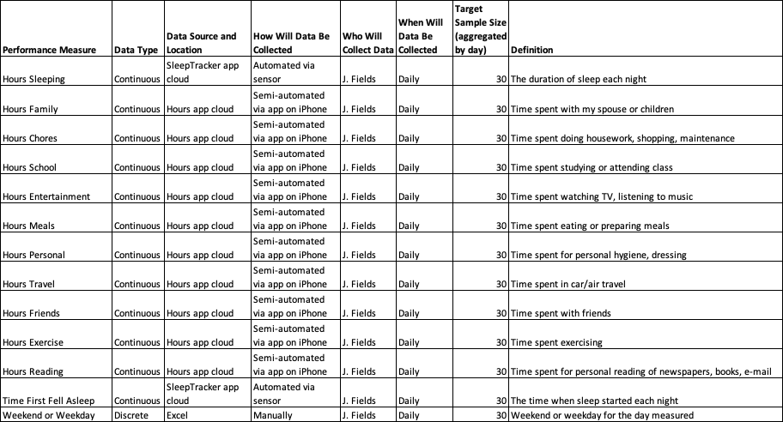
Sleep improvement project
Measure - Data Measurement Plan
Measurement Error:
An Apple iOS app called Hours was used to collect continuous data over a 24 hour period. During the Measure & Analyze Phases, an average of 23.7 hours of data was collected each day so .3 hours was missed
For travel days away from home, there is additional error in the total sleep time and first fell asleep time due to having to manually track this rather than with the automated SleepTracker system at my home

Slide 5
Sleep improvement project
Analyze – Sigma Quality Level (SQL)
WHY
SQL can be used to determine if a process is capable of meeting stakeholder requirements
DEFINITION
SQL serves as an indicator of how often defects are likely to occur in processes, parts or products
RESULT
A defect is defined as a night where the total sleep duration is less than 7.6 hours per night
 | Before | After
Defect opportunities per unit | 1 | 1
Units produced | 30 | 12
Total possible defects | 30 | 12
Total actual defects | 21 | 3
Defect per opportunity rate | 70% | 25%
DPMO | 700,000 | 250,000
SQL value | 1.0 | 2.1
SQL
1.0
SQL
2.1

Slide 6
Sleep improvement project
Analyze – Pareto Chart
WHY
A Pareto Chart shows the X variables as bars in decreasing order from left to right and the cumulative percent as a line
DEFINITION
Pareto Principle: 20% of the sources cause 80% of the problem
RESULT
The Pareto Chart helped to understand the distribution of time across the different X variables. However, it did not help to understand which X’s had the biggest impact on Total Sleep (Y). Other statistical techniques would help to answer this question.

Slide 7
Sleep improvement project
Analyze – Box & Whisker Plot
WHY
A Box & Whisker plot was used to compare the medians and outliers from the Measure and Improve phases
DEFINITION
A graphical tool to compare different medians and to show the variation in different groups of data
RESULT
During the Measure phase, the mean and median lines were close to each other and there was one extreme outlier
During the Improve phase, the “box” shows more concentrated data values and the lower ”whisker” is inside the box. There were no extreme outliers in this phase.

Slide 8
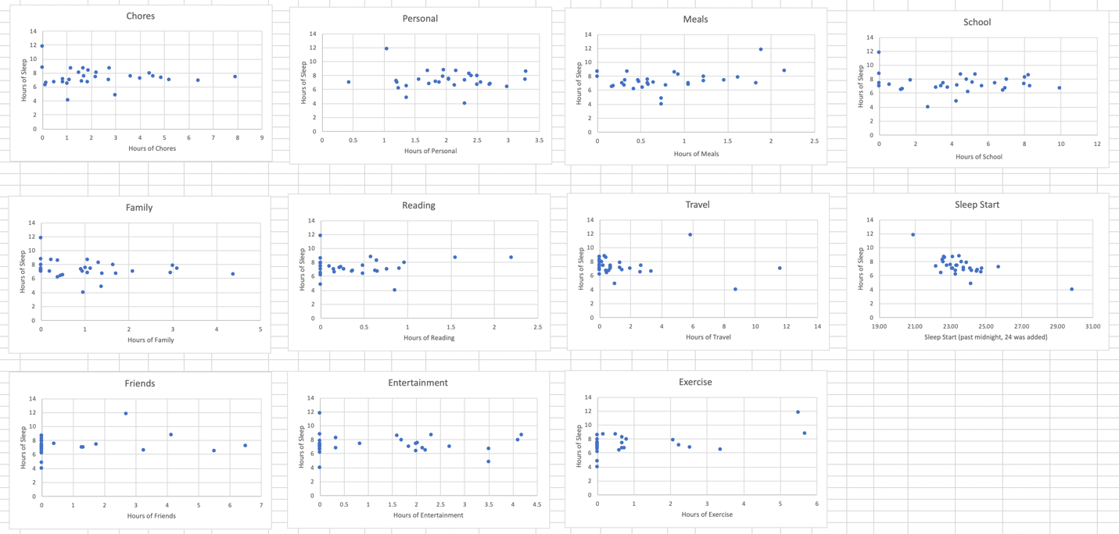
Sleep improvement project
Analyze – Scatterplots
WHY - A graphical representation was used to see if there is a relationship between the X’s and Y (total sleep time)
DEFINITION – A scatterplot is used to summarize the relationship between two quantitative variables that have been measured on the same element
RESULT – The scatterplots for the X variables indicated a slight positive linear pattern for Chores, Personal, Meals, School and Exercise. Sleep Start showed a stronger negative relationship with two outliers.

Slide 9
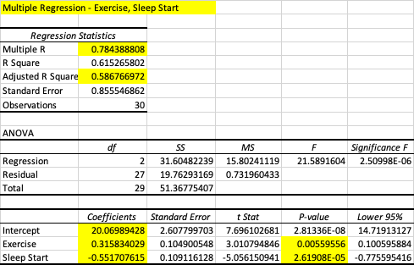
Sleep improvement project
Analyze – Multiple Linear Regression
WHY – To understand the relationship between the process output (y) and the process inputs (x’s) that could affect it
DEFINITION
P = probability
Adjusted R Square = explains the variability
Multiple R = correlation coefficient
RESULT
The multiple linear regression on all continuous X values shows that Sleep Start has the only low P-value
Exercise had a high P-value but was included in the second regression equation because it had a higher correlation (.5) as shown on the next slide
A second regression was performed with only Sleep Start and Exercise as X’s and this resulted in the Regression formula shown
These two X’s explain 59% of the variability (Adjusted R Square) and have 78% correlation (Multiple R). Since these values are lower than desired, a hypothesis test will be performed to validate the hypothesis below:
Ho: m1>=m2
Ha: m1<m2
＾
Regression Equation: y =20.07+.32x₁ -.55x₂
X₁ = Exercise, X₂ = Sleep Start

Slide 10
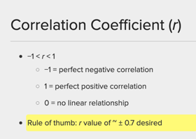
Sleep improvement project
Analyze – Correlation
WHY – Correlation was used to determine the strength of the linear relationship between the X variables and Y
DEFINITION – Correlation (R) is a measure of the strength and direction of the linear relationship. However, correlation by itself does not imply causation and other factors must be considered when using this tool.
RESULT
Exercise had a positive correlation of .5
Sleep Start had a negative correlation of .7

Slide 11


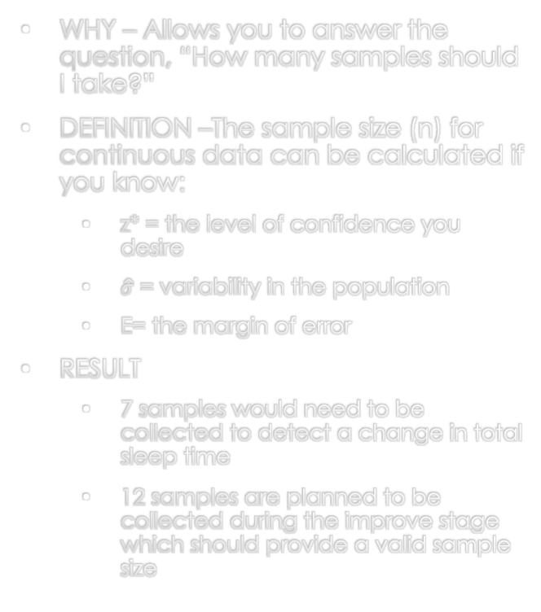




Sleep improvement project
Analyze - Sample Size
WHY – Allows you to answer the question, “How many samples should I take?”
DEFINITION –The sample size (n) for continuous data can be calculated if you know:
z* = the level of confidence you desire
$\hat{σ}$ = variability in the population
E= the margin of error
RESULT
7 samples would need to be collected to detect a change in total sleep time
12 samples are planned to be collected during the improve stage which should provide a valid sample size
2
$$z∗@ 95\% confidence=1.96$$
$$n=z∗\hat{σ}$$
E
$\hat{σ}$ = 1.33
$$E=1$$
2
$n=1.96∗$ $1.33$
$$=6.8≅7$$
1

Slide 12
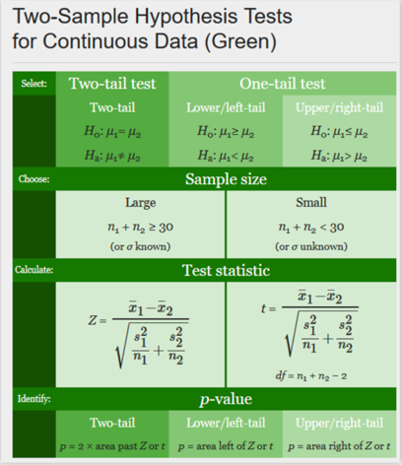
Sleep improvement project
Improve –Descriptive Statistics & Hypothesis Testing
WHY – Hypothesis testing uses statistics to tell us the probability that a hypothesis is true
DEFINITION – The Hypothesis calculation determines the Z or t value. The probability (p-value)can then be looked up in a table and if this is below alpha (typically .05) then the Original Hypothesis (Ho) is null and the Alternative Hypothesis (Ha) is accepted as true
RESULT
Hypothesis:
Ho: m1>=m2
Ha: m1<m2
m1 = mean total sleep in Measure
m2 = mean total sleep in Improve
Although the mean value for total sleep increased from 7.29 to 7.54 hours, there is not a statistical difference in the data sets since p=.25 which is higher than our alpha of p=.05
Therefore, Ho: m1>=m2 is not rejected

Slide 13
Sleep improvement project
Control – Control Chart
MEASURE PHASE
IMPROVE PHASE
WHY – Control charts show the variations in a process and allow you to visually see if a process is consistent and predictable
DEFINITION – Control charts are a tool which calculates the moving range and individual x variables over time to see if these fall within the upper and lower control limits of a process
RESULT
During the Measure Phase, the process was out of control on Day 18 when there was a significant change in the sleep pattern
During the Improve Phase, the process was under control and within the Upper and Lower Control limits

Slide 14
Sleep improvement project
Conclusion
The goal for this project was to increase Total Sleep per night from 7.29 to 7.60 hours (4%)
During the Analyze Phase, the regression/correlation analysis showed that Sleep Start and Exercise were the two X’s that if changed could have the greatest impact on my Y (Total Sleep)
By going to bed at a mean of 11pm and exercising 1 hour per day, the regression formula predicted that Total Sleep would increase from 7.29 to 7.74 hours per night
During the Improve Phase, the Sleep Start mean improved from 11:36 to 11:00pm. Unfortunately, Exercise decreased during Improve from .88 to .65 hours per day.
At the end of the Improve Phase, the mean for Total Sleep per night increased from 7.29 to 7.54 hours per night (3.4% increase). This was close to the goal of 7.60 hours (4% increase).
When conducting a left-tail, two-sample hypothesis test, the p-value was .24 which was higher than my alpha value of .05. So, although there was an improvement in Total Sleep, we can not conclude with 95% certainty that the improvement was statistically significant.
Ho: m1>=m2 is not rejected
m1=mean total sleep during Measure
m2=mean total sleep during Improve
More data collection and analysis is needed to determine if the improvements were too small or the wrong X variables were selected during the Analyze phase

